Slide 1
Pliocene- Pleistocene breakup of the Sierra Nevada-White-Inyo Mountains Block and Formation of Owens Valley
Steven B. Bachman

Slide 2
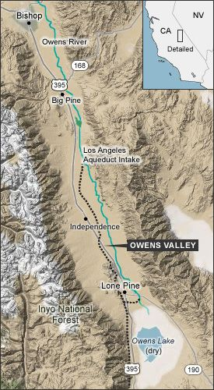
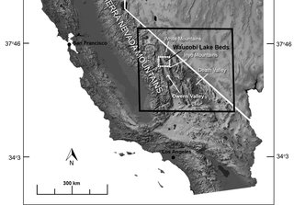
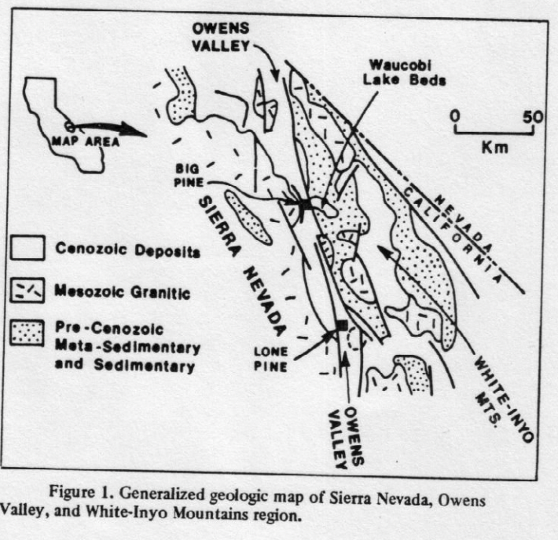

Slide 3
Introduction
The Owens Valley is a North trending fault bounded depression between the Sierra Nevada and the White-Inyo mountains.
White-Inyo Mountains are principally underlain by Precambrian and Paleozoic (260-4600 MA) sedimentary rocks with patches of Mesozoic (100-251 MA) rocks.
Sierra-Nevada underlied by Mesozoic (100-251 MA) intrusive rocks.
The Waucobi lake beds appear to be the oldest Cenozoic (0.01-65.5 MA) sedimentary deposits in the Owens Valley.
These deposits record the initial formation of the valley and the uplift of the White-Inyo mountains.
These Plio-Plistocene sedimentary rocks are as much as 100m thick and are ~7km East of Big Pine.

Slide 4
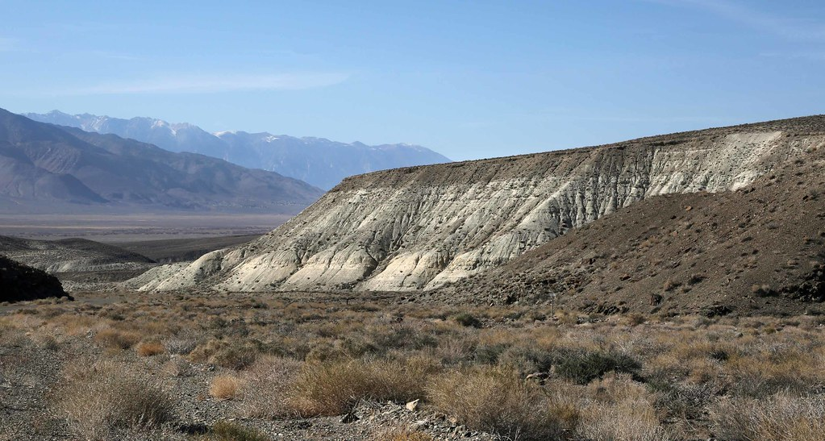
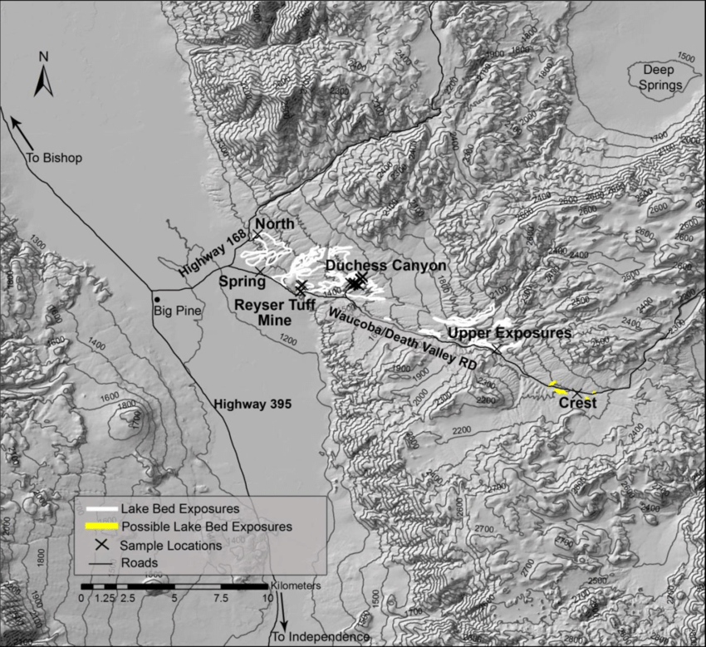
Waucobi Lake Beds
. Hays (1966): potassium-argon (K-Ar) dating has shown an age of 2.3 m.y. for feldspar crystals in the upper lake beds.
. Paleomagnetic work on the sedimentary rocks reveals reversed polarity for all beds below those dated by Hays.
. Lowest beds exposed were probably deposited after 2.43 m.y and before .69 m.y.

Slide 5
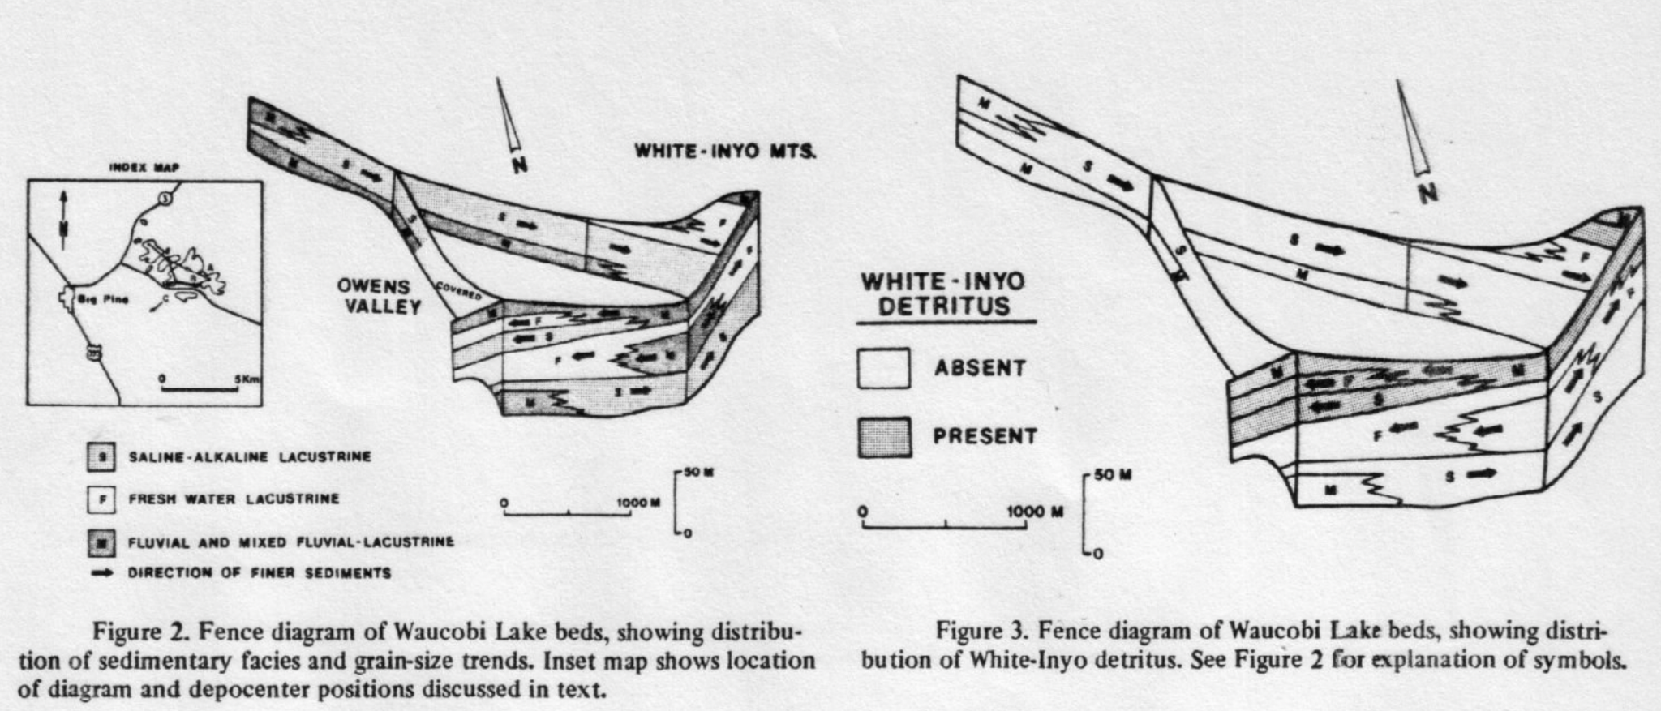
. 3 major facies of the Waucobi lake beds are: Saline-Alkaline lacustrine, freshwater lacustrine and fluvial with minor lacustrine beds.
. Paleocurrent indicators suggest that currents were related to local shoreline irregularities and prevailing wind directions.
. As suggested by figure 2, the depocenter progressively shifted from the East (position A) to the West (position C).

Slide 6
. Two main sources of Detritus present:
Sedimentary and metasedimentary could from White-Inyo mtns to the East.
White granitic material from the Sierra.
. Granitic detritus is found only in the lower saline & freshwater deposits.
. Deposits from White-Inyo mtns was deposited in late stages of lower freshwater episode & became the dominant sediment.
. Occurrence of metasedimentary detritus coincides with the beginning of Westward shift of the basin.

Slide 7
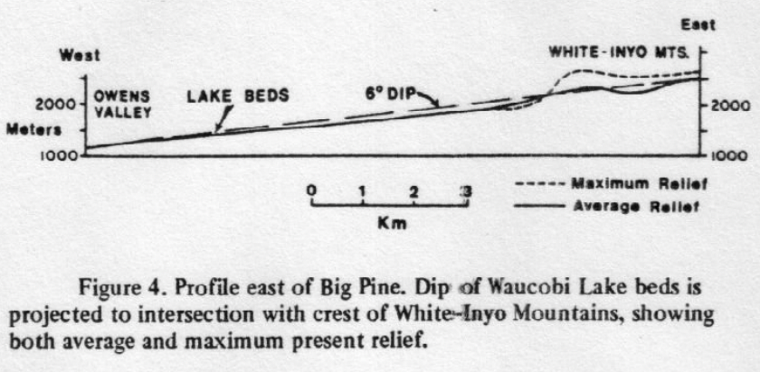
Uplift of Waucobi Lake Beds.
The change in sedimentary source direction and shift in location of the depocenter may mark the beginning of significant uplift of the White-Inyo mountains and depression of the Owens Valley.
The Waucobi embayment is a gentle slope that goes from 1,200m on the West to 2,200m on the East.
The constant Westward dip and continuous outcrops suggest that sediment and bedrock embayment were tilted as a unit

Slide 8
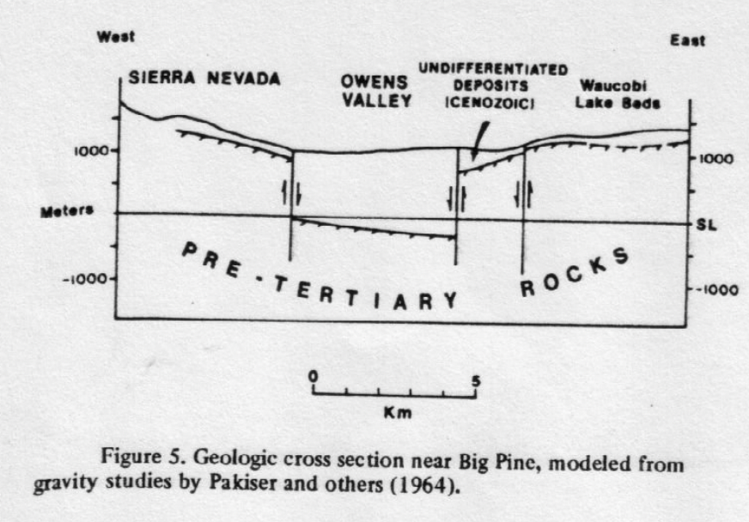
This 6deg dip of the lake beds towards the crest of the White-Inyo mtns allows one to calculate the amount of uplift of the White-Inyo mountains relative to the Waucobi embayment.
Elevation difference ranges from 1000m to 1100m.
Known vertical throw on faults in the embayment increases the estimate uplift by at least 100m
Thus, the amount of uplift in the Waucobi embayment in the last 2.3 m.y. Was roughly 1,200 m.

Slide 9
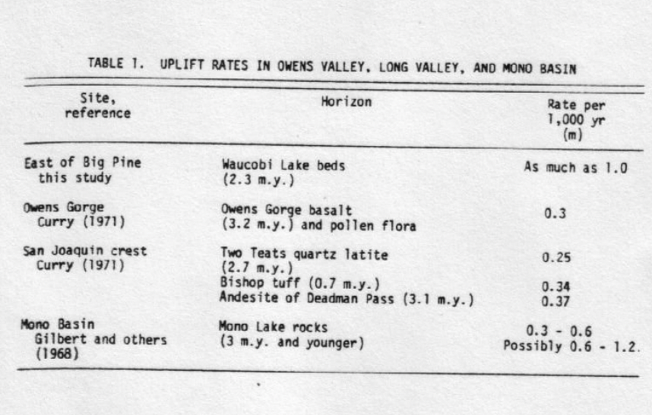
. If one assumes the extreme case that the Waucobi Lake beds were deposited directly on Owens Valley bedrock, the west end of the lake beds would have been downfaulted a maximum of 1,100 m.
. Adding said uplift results in a total differential movement between Owens Valley and the White-Inyo mtns of as much as 2,300 m in the last 2.3 m.y.

Slide 10
Late Cenozoic tectonic history in the Owens Valley:
Early-Mid Pleistocene the mountain block in what is now the greater Owens Valley area was a topographical high.
The Sierra escarpment began in the late Pliocene (2.3 to 3.4 mya) by downwarp flexure followed by faulting and volcanism.
The Waucobi Lake formed 2.3 to 2.34 mya on the Sierra-White-Inyo mountain block, in a depression that may have been initiated by growth of the Sierra.
Soon after, uplift in the White-Inyo mountains began, shifting the Waucobi basin to the west .
Fault movement along the Sierran escarpment and westward tilting of the White-Inyo mountains shifted the Waucobi lake basin to present Owens Valley.
Present topography formed during the past 2.3 m.y. As Owens Valley continued to be downfaulted. Relative uplift between the valley and White-Inyo mtns may be ~2,300 m during this time.

